Slide 1
COMP5318: Machine Learning and Data Mining Adminstrivia
Unit coordinator: Dr. Nguyen Tran
School of Computer Science

Slide 2
Welcome
Notes:
Welcome
As per normal process
Include a welcome to any students joining the class online.
Explain that as well as the usual emergency procedures there will be a short overview of guidelines for keeping our campus and community safe, to help manage the spread of coronavirus.

Slide 3
Acknowledgement of Country
I would like to acknowledge the Traditional Owners of Australia and recognise their continuing connection to land, water and culture. I am currently on the land of the Gadigal (Cadigal) people of the Eora Nation and pay my respects to their Elders, past, present and emerging.
I further acknowledge the Traditional Owners of the country on which you are on and pay respects to their Elders, past, present and future.
Notes:
For details of traditional custodians of campuses and facilities visit the intranet page below.
https://intranet.sydney.edu.au/contacts-campuses/campus-information/traditional-custodians-of-the-land.html
For other locations refer to the AIATSIS map of Indigenous Australia
https://aiatsis.gov.au/explore/articles/aiatsis-map-indigenous-australia

Slide 4
Emergency procedures (on campus)
In the unlikely event of an emergency we may need to evacuate the building.
If we need to evacuate, we will ask you to take your belongings and follow the green exit signs .
We will move a safe distance from the building and maintain physical distancing whilst waiting until the emergency is over.
In some circumstances, we might be asked to remain inside the building for our own safety. We call this a lockdown or shelter-in-place.
Further information is available at www.sydney.edu.au/emergency
Notes:
Due to physical distancing requirements building occupants are not gathering at the usual assembly area when evacuating. The advice is to disperse rather than assemble but you should keep your class together (with physical distancing) if you intend to return to class once the emergency is over. If you intend to end the class, you can let the students disperse.

Slide 5
Keeping our community safe
We can all help reduce the spread of COVID-19 through following good hygiene practices:
Wash hands regularly, for at least 20 seconds with soap and water, or use an alcohol-based hand rub.
Cover your mouth when coughing and sneezing with a tissue or a flexed elbow.
Maintain a distance of at least 1.5m between yourself and others, where possible.
Avoid large gatherings, where possible.
Avoid close contact with anyone with cold or flu symptoms, e.g. fever, cough, runny nose or shortness of breath.
Notes:
Remind students to follow guidelines for health management when coming to campus, to protect the health of our students and staff.
Following good hygiene practices on or off campus will also help protect the broader community.

Slide 6
Keeping our community safe
All students and staff who have cold or flu symptoms should isolate themselves from others.
If you are unwell with cold or flu symptoms please excuse yourself from this class and we will support you to continue the work remotely.
Make sure you read the information on special consideration in the unit outline.
Notes:
As a precaution, and generally as good practice, we are asking all students and staff who have cold or flu symptoms to isolate themselves from others and get tested for COVID-19.
If you are have these symptoms, please excuse yourself from this class (even if you are wearing a surgical mask) and we will support you to continue the work remotely or bring you up to speed asap.
Make sure you read the information on special consideration in the unit outline.

Slide 7
Keeping our community safe
The University is following advice from the government and related public health authorities.
For the latest information, see the advice on the University website.
In some classes, especially those involving use of shared equipment, please follow additional advice from your coordinators.
Please take care of each other and yourselves and if you need support reach out to your unit coordinator or the health and wellbeing area of the Current Students website.
Notes:
Provide students with additional details for unit of study as applicable.

Slide 8
Tips for students joining online
Remember that you are still in a space with other students.
Mute your microphone when not speaking.
Use earphones or headphones - the mic is better and you'll disturb others less.
If you have a webcam, please switch it on so we can see you!
If you are speaking to the camera, make eye contact with the camera (and therefore your classmates and teacher).
Try not to talk over someone else.
Use the chat function to send messages to the teacher or classmates during class.
Notes:
For those of you haven’t taken part in online classes before, here are a few tips to help make it a great experience and ways to communicate with each other during the class.

Slide 9
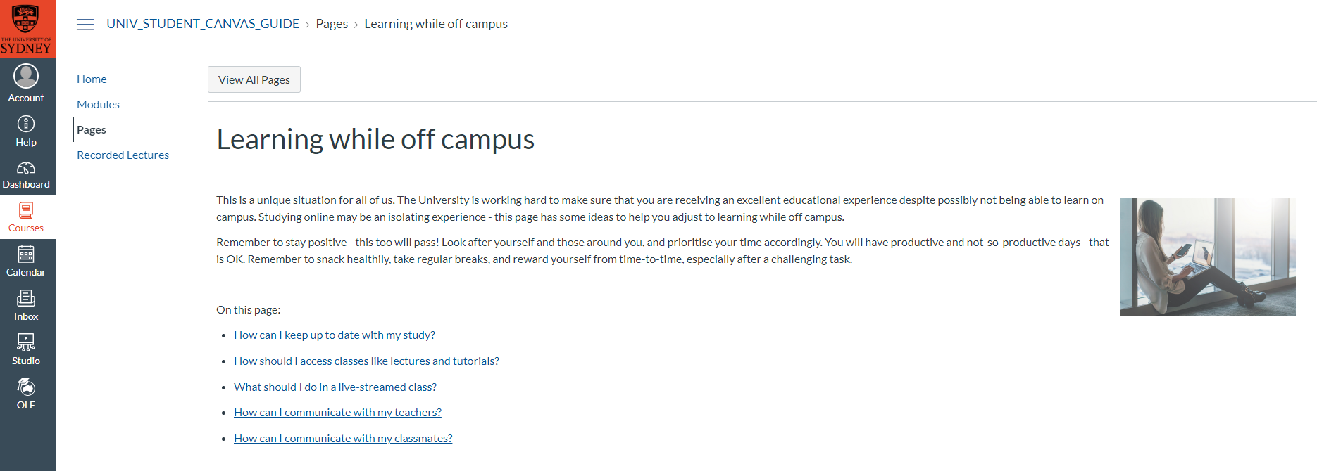
Tips for students learning online
For tips and guides on learning online and the tools you will use, refer to Learning while off campus resources in Canvas.
Notes:
Visit Canvas to access resources to support your online learning experience.

Slide 10
Reminder
For the second and subsequent sessions

Slide 11
Keeping our community safe
Remember good hygiene practices and physical distancing:
Frequent handwashing
Cough or sneeze into a tissue or your flexed elbow
Maintain a distance of at least 1.5m between yourself and others, where possible
Avoid large gatherings, where possible.
If you are unwell with cold or flu symptoms please excuse yourself from this class and we will support you to continue the work remotely.

Slide 12
Agenda
Unit arrangements
Expectations
Assessment
Unit details
Policies
Workplace Health and Safety
Assistance
Advice

Slide 13
COMP5318: Places
Lecture: every Monday, 6 to 8pm online with Zoom.
Lab: depends on your timetable
Go to the lab you are scheduled for
If for some reason you miss it, you can attend a later lab session if there is space and the tutor agrees, but ask the tutor before taking a seat
Do not miss class, except for illness, emergencies, etc
Get help from staff if you feel you are falling behind

Slide 14
COMP5318: People
Instructors
Unit coordinator and lecturer: nguyen.tran@sydney.edu.au
Phone:+61 2 8627 7221, Office: Rm 428, J12.
Even if someone else is currently lecturing, this is the person who deals with all paperwork and admin issues
Illness or misadventure
Rules and policies
Group difficulties
Lecturer: Dr. Nguyen Tran
Tutors: depends on your timetable

Slide 15
COMP5318: Resources
Canvas: https://canvas.sydney.edu.au/
Login using Unikey and password
Link to Units website: https://sydney.edu.au/units/
Official schedule, list of learning outcomes, etc
Copies of slides
Lab instructions
Assignment instructions
?Lecture videos
We intend to record the lectures, but the technology is not reliable
Submit official assignment work on canvas;
see your grades; etc
Discussion forum: on edstem, link from Canvas site

Slide 16


COMP5318 Reference book
2 references books:
Machine Learning: A Probabilistic Perspective (https://www.cs.ubc.ca/~murphyk/MLbook/)
Mining of Massive Data Sets (http://infolab.stanford.edu/~ullman/mmds.html
This and other relevant works can be found in the university library

Slide 17
Expectations
Students attend scheduled classes, and devote an extra 6-9 hrs per week
doing assessments
preparing and reviewing for classes
revising and integrating the ideas
practice and self-assess
Students are responsible learners
Participate in classes, constructively
Respect for one another (criticize ideas, not people)
Humility: none of us knows it all; each of us knows valuable things
Check Canvas site at least once a week!
Notify academics whenever there are difficulties
Notify group partners honestly and promptly about difficulties

Slide 18
Self-test
How much work will you be devoting to this unit, each week?
Do you need to buy a book?
Who should you see if difficulties arise?

Slide 19
COMP5318: Task
2 assignments during the course
Individual coding (Python, Assignment 1)
Group project (Python, Assignment 2)
Quiz (Week 6)
Exam
Note: coding will be required to run in the CS lab environment
if you work on a home machine, check it in the lab too!

Slide 20
COMP5318 Quiz
Due in week 6
Worth 15% of the unit
Individual

Slide 21
COMP5318 Assignment 1
Due in week 9
Worth 15%
Description: Individual

Slide 22
COMP5318 Assignment 2
Due in week 12
Worth 20%
Description: Groups of 3 students, method comparison and analysis

Slide 23
COMP5318 Exam
Worth 50% of the unit
Covers content of the unit
School of Computer Science policy: you must get at least 40% of the marks available on the exam, in order to pass the unit

Slide 24
Special Consideration (University policy)
If your performance on assessments is affected by illness or misadventure
Follow proper bureaucratic procedures
Have professional practitioner sign special USyd form
Submit application for special consideration online, upload scans
Note you have only a quite short deadline for applying
http://sydney.edu.au/current_students/special_consideration/
Also, notify coordinator by email as soon as anything begins to go wrong
There is a similar process if you need special arrangements eg for religious observance, military service, representative sports

Slide 25
Late assessments in COMP5318
Suppose you hand in work after the deadline:
If you have not been granted special consideration or arrangements
A penalty of 5% of the maximum marks will be taken per day (or part) late. After ten days, you will be awarded a mark of zero.
e.g. If an assignment is worth 40% of the final mark and you are one hour late submitting, then the maximum marks possible would be 38%.
e.g. If an assignment is worth 40% of the final mark and you are 28 hours late submitting, then the maximum marks possible marks would be 36%.
Warning: submission sites get very slow near deadlines
Submit early (12 hours in advance); you can resubmit if there is time before the deadline

Slide 26
Academic Integrity (University policy)
“The University of Sydney is unequivocally opposed to, and intolerant of, plagiarism and academic dishonesty.
Academic dishonesty means seeking to obtain or obtaining academic advantage for oneself or for others (including in the assessment or publication of work) by dishonest or unfair means.
Plagiarism means presenting another person’s work as one’s own work by presenting, copying or reproducing it without appropriate acknowledgement of the source.” [from site below]
http://sydney.edu.au/elearning/student/EI/index.shtml
Submitted work is compared against other work (from students, the internet, etc)
TurnitIn for textual tasks (through Canvas), other systems for code
Gradescope
Penalties for academic dishonesty or plagiarism can be severe

Slide 27
Self-test
When is the first assessment work due?
What do you do if you get sick during semester?
What help can you use when answering assessments?
How do you find out about assignment instructions?
How do you submit your work?
What is TurnitIn?
What language will you be coding in?

Slide 28
Academic Integrity Practice
School of Computer Science

Slide 29
Different levels/types of Academic Integrity practice
Source:
Different types of sources of help are accepted for different academic levels (Junior, Intermediate, Senior, Postgraduate)
Nature of Help:
Different types of help are accepted for different types of assessment.
Two slides explaining “Source” and “Nature” of help allowed
You can adjust the chart to suite the academic integrity requirement for your assessments.

Slide 30
Example 1: Junior level programming UoS
Source of Help
Lecturer | Teaching Assistants / Tutors | Classmates | Private tutors | Online forums/ Online tutors | Students outside course/UoS | Hired coders Tutorial Company outside University | Relatives | Other
Individual assessment
A student needs to gain an understanding of fundamental knowledge/skills
It is important to master the knowledge/skills themselves
Encouraged
Attribution required
Not acceptable
Ask Lecturer/Coordinator

Slide 31
Example 1: Junior level programming UoS
Types of Help
Understanding General Concepts | Explained using similar material (not assignment) | Sharing approach/concept to derive assignment solution | Designing code/solution | Implementing code/solution
Individual assessment
A student needs to gain an understanding of fundamental knowledge/skills
It is important to master the knowledge/skills themselves
Students are encouraged to obtain help through relevant teaching material and practices but not directly on assessment materials
Encouraged
Attribution required
Not acceptable
Ask Lecturer/Coordinator

Slide 32
Example 2: Intermediate/Senior level specialist UoS
Source of Help
Lecturer | Teaching Assistants / Tutors | Classmates | Private tutors | Online forums/ Online tutors | Students outside course/UoS | Hired coders Tutorial Company outside University | Relatives | Other
Individual assessment
A student needs to gain an understanding of high level knowledge/skills
A student needs to gain skills to find, evaluate and apply existing knowledge/solutions
Encouraged
Attribution required
Not acceptable
Ask Lecturer/Coordinator

Slide 33
Example 2: Intermediate/Senior level specialist UoS
Types of Help
Understanding General Concepts | Explained using similar material (not assignment) | Sharing approach/concept to derive assignment solution | Designing code/solution | Implementing code/solution
Individual assessment
A student needs to gain an understanding of fundamental knowledge/skills
It is important to master the knowledge/skills themselves
Students are encourage to obtain help through relevant teaching material and practices
Encouraged
Attribution required
Not acceptable
Ask Lecturer/Coordinator

Slide 34
WHS Induction
School of Computer Science

Slide 35





General Housekeeping – Use of Labs
Keep work area clean and orderly
Remove trip hazards around desk area
No food and drink near machines
No smoking permitted within University buildings
Do not unplug or move equipment without permission

Slide 36
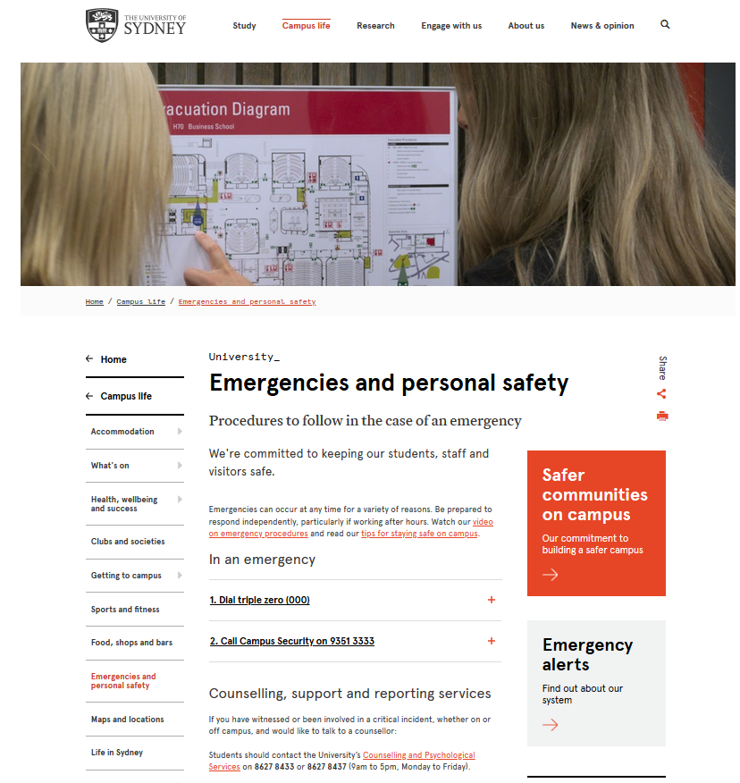
EMERGENCIES – Be prepared
https://sydney.edu.au/campus-life/safety-security.html

Slide 37
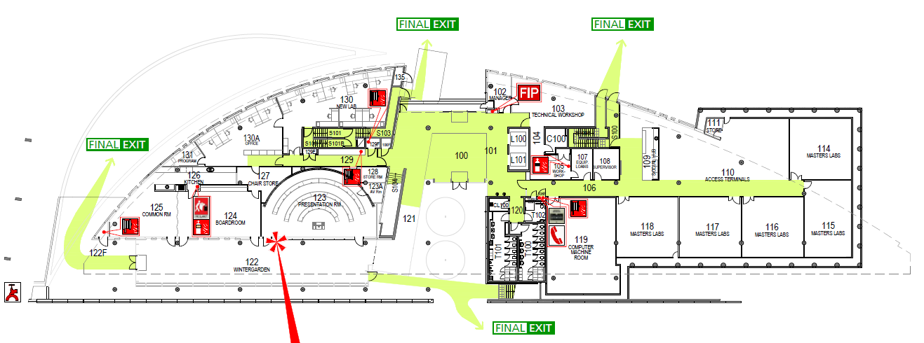
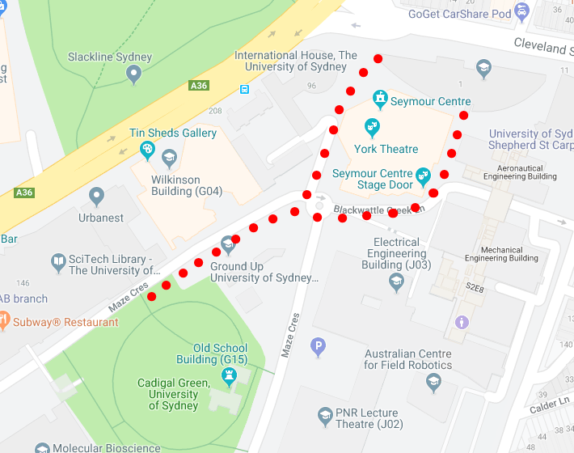
EMERGENCIES
Where is your closest safe exit ?
Assembly Area: Cadigal Green

Slide 38
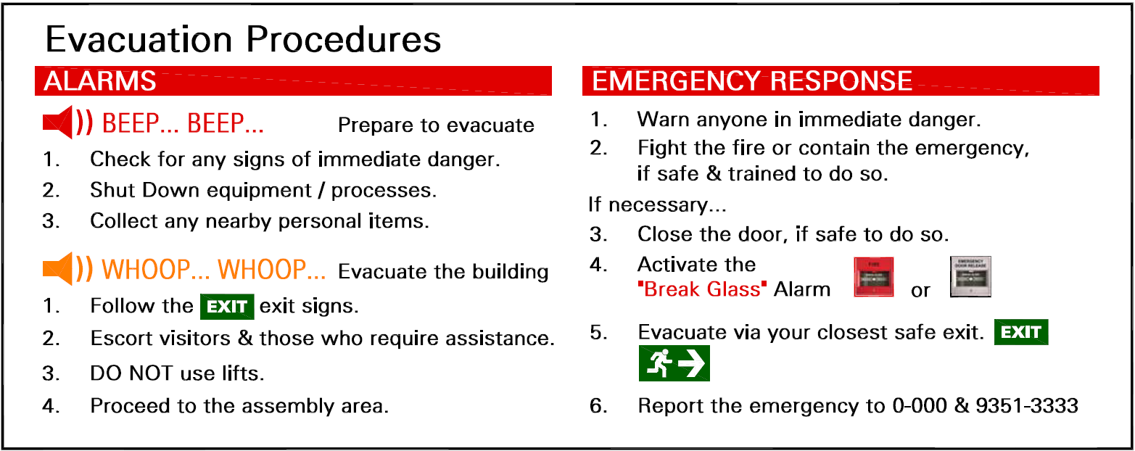
EMERGENCIES

Slide 39


MEDICAL EMERGENCY
l
If a person is seriously ill/injured:
call an ambulance 0-000
notify the closest Nominated First Aid Officer
If unconscious– send for Automated External Defibrillator (AED) AED locations.
NEAREST to CS Building (J12)
- Electrical Engineering Building, L2 (ground) near lifts
- Seymour Centre, left of box office
- Carried by all Security Patrol vehicles
call Security - 9351-3333
Facilitate the arrival of Ambulance Staff (via Security)
Nearest Medical Facility
University Health Service in Level 3, Wentworth Building
First Aid kit – SIT Building (J12)
kitchen area adjacent to Lab 110

Slide 40

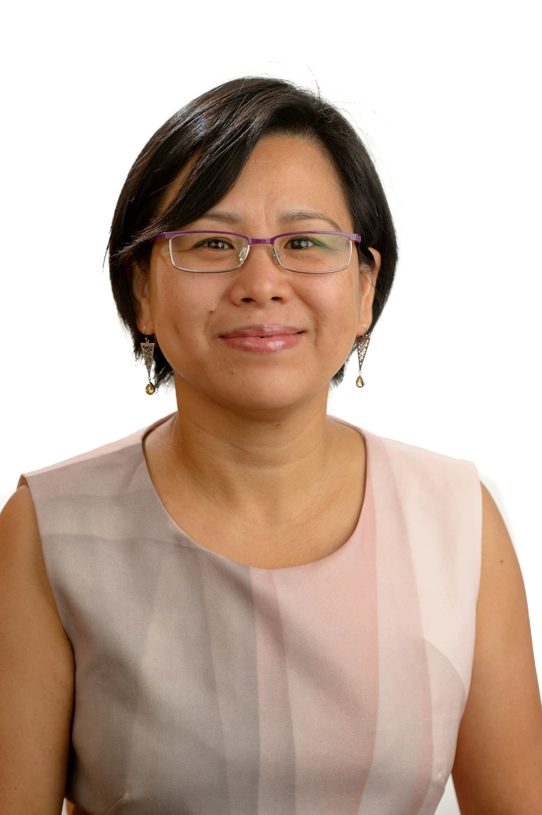


School of Computer Science Safety Contacts
CHIEF WARDEN Greg Ryan
Level 1W 103
9351 4360
0411 406 322
Orally REPORT all
INCIDENTS
& HAZARDS
to your SUPERVISOR
FIRST AID OFFICERS
OR
Julia Ashworth
Level 2E Reception
9351 3423
Undergraduates: to Katie Yang
9351 4918
Coursework
Postgraduates: to Cecille Faraizi
9351 6060
or Keiko Narushima
8627 0872
CS School
Manager: Priyanka Magotra
8627 4295
Will Calleja
Level 1W 103
9036 9706
0422 001 964
Katie Yang
Level 2E 237
9351 4918

Slide 41
Assistance
There are a wide range of support services available for students: https://sydney.edu.au/campus-life/health-wellbeing-success.html
Please make contact, and get help
You are not required to tell anyone else about this
If you are willing to inform the unit coordinator, they may be able to work with other support to reduce the impact on this unit
eg provide advice on which tasks are most significant

Slide 42
DISABILITY SERVICES
Do you have a disability?
You may not think of yourself as having a ‘disability’ but the definition under the Disability Discrimination Act is broad and includes temporary or chronic medical conditions, physical or sensory disabilities, psychological conditions and learning disabilities.
The types of disabilities we see include:
anxiety, arthritis, asthma, asperger's disorder, ADHD, bipolar disorder, broken bones, cancer, cerebral palsy, chronic fatigue syndrome, crohn’s disease, cystic fibrosis, depression, diabetes, dyslexia, epilepsy, hearing impairment, learning disability, mobility impairment, multiple sclerosis, post traumatic stress, schizophrenia , vision impairment, and much more.
Students needing assistance must register with Disability Services –
it is advisable to do this as early as possible.
http://sydney.edu.au/study/academic-support/disability-support.html

Slide 43
Disability Services Office sydney.edu.au/disability 02-8627-8422
Do you have a disability?
You may not think of yourself as having a ‘disability’ but the definition under the Disability Discrimination Act (1992) is broad and includes temporary or chronic medical conditions, physical or sensory disabilities, psychological conditions and learning disabilities.
The types of disabilities we see include:
Anxiety // Arthritis // Asthma // Autism // ADHD
Bipolar disorder // Broken bones // Cancer
Cerebral palsy // Chronic fatigue syndrome
Crohn’s disease // Cystic fibrosis // Depression Diabetes // Dyslexia // Epilepsy // Hearing impairment // Learning disability // Mobility impairment // Multiple sclerosis // Post-traumatic stress // Schizophrenia // Vision impairment
and much more.
Students needing assistance must register with Disability Services. It is advisable to do this as early as possible. Please contact us or review our website to find out more.

Slide 44
Other support
Learning support
http://sydney.edu.au/study/academic-support/learning-support.html
International students
http://sydney.edu.au/study/academic-support/support-for-international-students.html
Aboriginal and Torres Strait Islanders
http://sydney.edu.au/study/academic-support/aboriginal-and-torres-strait-islander-support.html
Student organization (can represent you in academic appeals etc)
http://srcusyd.net.au/ or http://www.supra.net.au/
Please make contact, and get help
You are not required to tell anyone else about this
If you are willing to inform the unit coordinator, they may be able to work with other support to reduce the impact on this unit
eg provide advice on which tasks are most significant

Slide 45
Advice
Metacognition
Pay attention to the learning outcomes in Canvas
Self-check that you are achieving each one
Think how each assessment task relates to these
Time management
Watch the due dates
Start work early, submit early
Networking and community-formation
Make friends and discuss ideas with them
Know your tutor, lecturer, coordinator
Keep them informed, especially if you fall behind
Don’t wait to get help
Enjoy the learning!

